Slide 1
Greatness in the Kingdom
Kingdom Character
(Matt 5:1-12)

Slide 2
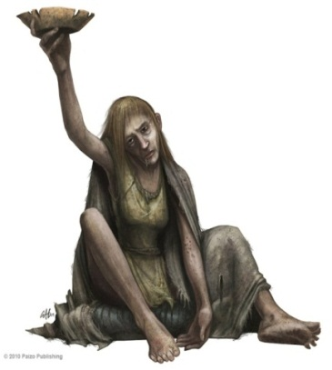
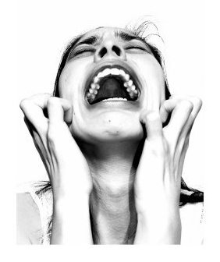
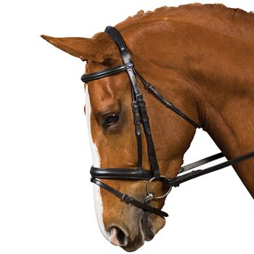
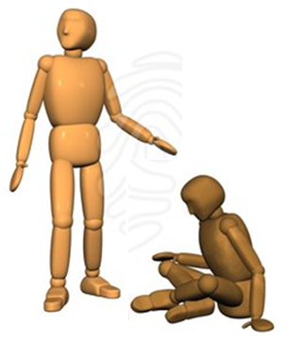
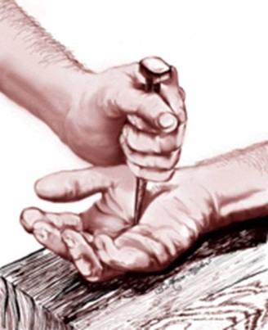
Greatness in the Kingdom
poor in spirit
(Matt. 5:3)
who mourn (Matt. 5:4)
the
meek
(Matt. 5:5)
hunger
& thirst
(Matt. 5:6)
show mercy
(Matt. 5:7)
pure in heart
(Matt. 5:8)
peace-makers
(Matt. 5:9)
persecuted
(Matt. 5:10)

Slide 3
Greatness in the Kingdom
Kingdom Character
(Matt 5:1-12)
Kingdom Calling
(Matt 5:13-16)

Slide 4
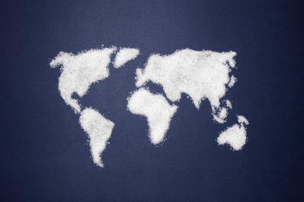
Greatness in the Kingdom
You are the salt of the earth
Matthew 5:13

Slide 5
Greatness in the Kingdom
Kingdom Character
(Matt 5:1-12)
Kingdom Calling
(Matt 5:13-16)
Kingdom Conduct
(Matt 5:17-7:27)

Slide 6
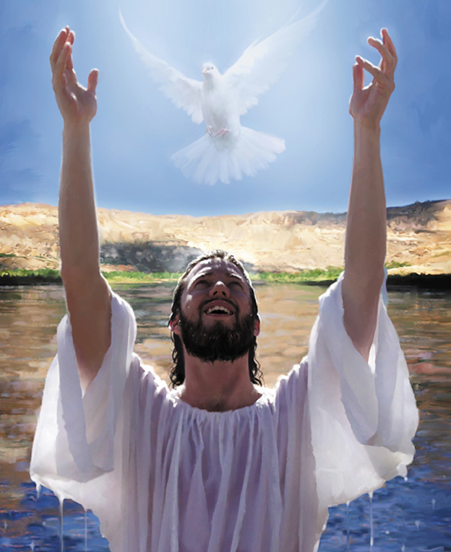
Greatness in the Kingdom
"This is my beloved Son, with whom I am well pleased.”
(Matthew 3:17)
"This is my beloved Son, with whom I am well pleased.”
(Matthew 17:5)
“Well done, good and faithful servant.”
(Matthew 25:23)

Slide 7
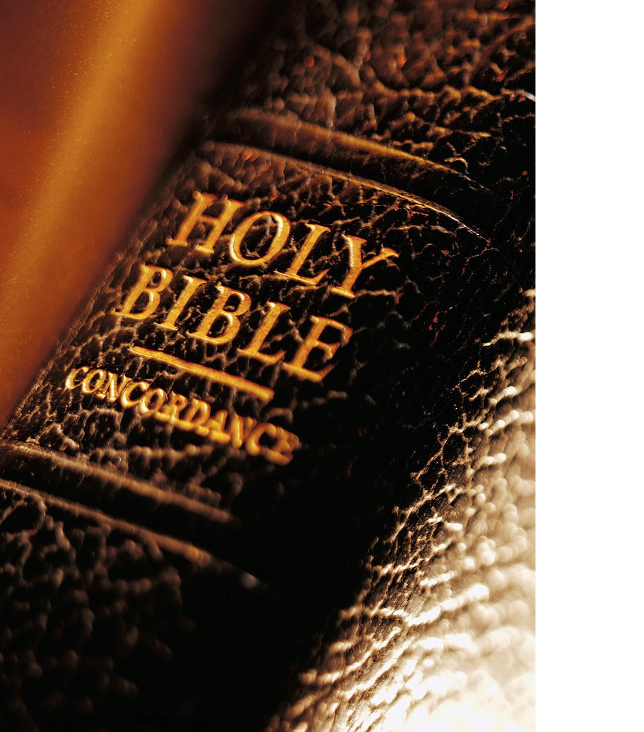
Matthew 5:17-20 ¹⁷ “Don’t misunderstand why I have come. I did not come to abolish the law of Moses or the writings of the prophets. No, I came to accomplish their purpose. ¹⁸ I tell you the truth, until heaven and earth disappear, not even the smallest detail of God’s law will disappear until its purpose is achieved.

Slide 8
Matthew 5:17-20 ¹⁹ So if you ignore the least commandment and teach others to do the same, you will be called the least in the Kingdom of Heaven. But anyone who obeys God’s laws and teaches them will be called great in the Kingdom of Heaven.

Slide 9
Matthew 5:17-20 ²⁰ “But I warn you—unless your righteousness is better than the righteousness of the teachers of religious law and the Pharisees, you will never enter the Kingdom of Heaven!

Slide 10
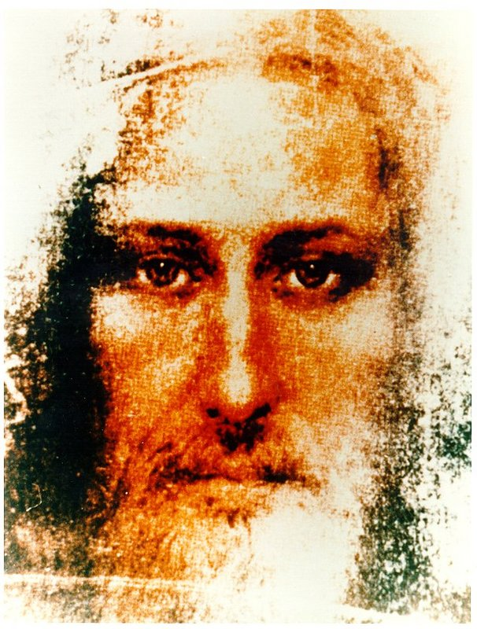
Greatness in the Kingdom
“A good man”
“A great prophet”
“A revolutionary”
“A trouble maker”
“The Messiah”
“Son of the living God”
Do not misunderstand why I have come.
(Matt. 5:17)

Slide 11
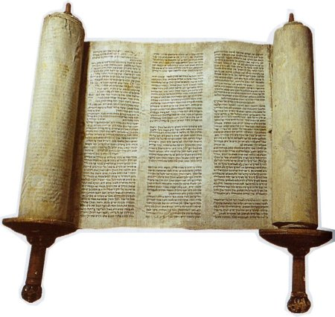
Greatness in the Kingdom
Tanakh $¾¾nt (Bible)
Torah (Law)
Nevi’im (Prophets)
Ketuvim (Writings)
not … to abolish the law and the prophets
(Matt. 5:17)

Slide 12
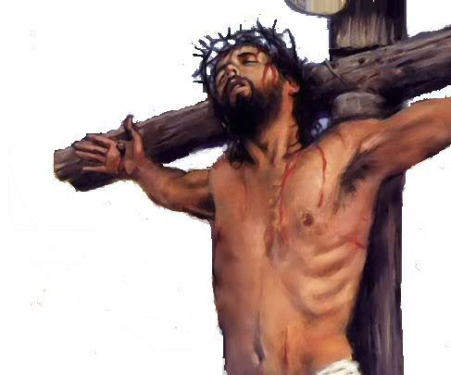
Greatness in the Kingdom
to repeal?
to modify?
to endorse?
to obey?
to fulfil (5:17)
For Christ is the end of
the law for righteousness to everyone who believes. (Romans 10:4)
… not to abolish … but to fulfil them ... (Matt. 5:17)

Slide 13
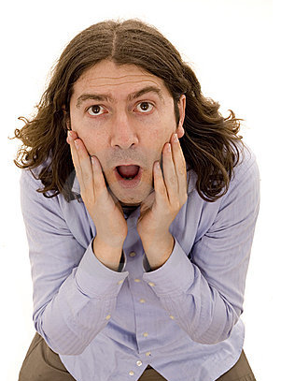
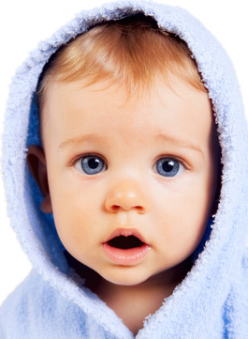
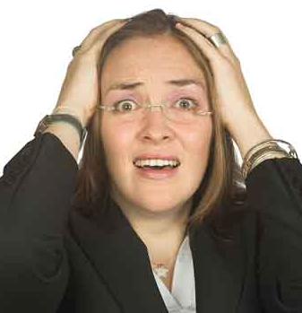
Greatness in the Kingdom
a s t o n i s h i n g !
… I tell you the truth …
(Matt. 5:18)

Slide 14
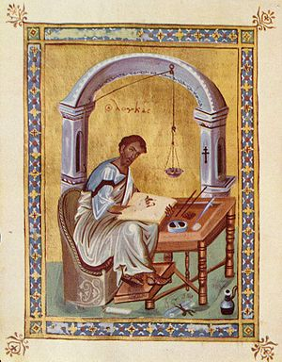
Greatness in the Kingdom
ih
tittle
jot
Marcion (c 85-160 AD)
Marcionism
Positive Christianity
New Testament Only
not even the smallest detail will disappear
(Matt. 5:18)

Slide 15
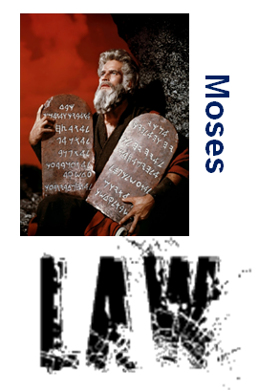
Greatness in the Kingdom
… and in your offspring shall all the nations of the earth be blessed … (Genesis 22:18)
“with these words I have made a covenant with you and Israel.”
(Exodus 34:27)
not even the smallest detail will disappear
(Matt. 5:18)

Slide 16
Greatness in the Kingdom
Is there a conflict, then, between God’s law and God’s promises? Absolutely not! If the law could give us new life, we could be made right with God by obeying it.
(Galatians 3:21)
The law was our guardian until Christ came; it protected us until we could be made right with God through faith. (Galatians 3:24)
For no one can ever be made right with God by doing what the law commands. The law simply shows us how sinful we are.
(Romans 3:20)
Well then, since God’s grace has set us free from the law, does that mean we can go on sinning? Of course not!
(Romans 6:15)
not even the smallest detail will disappear
(Matt. 5:18)

Slide 17
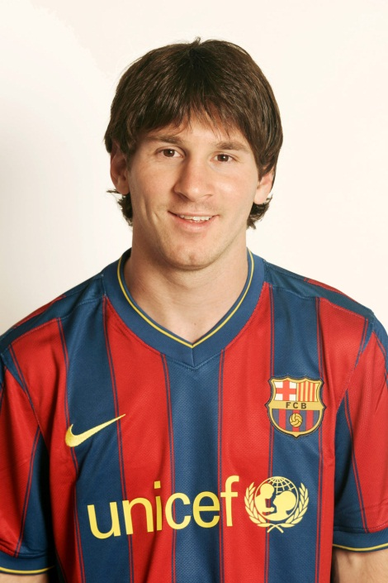
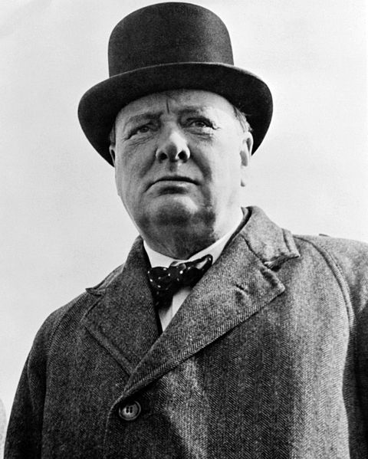
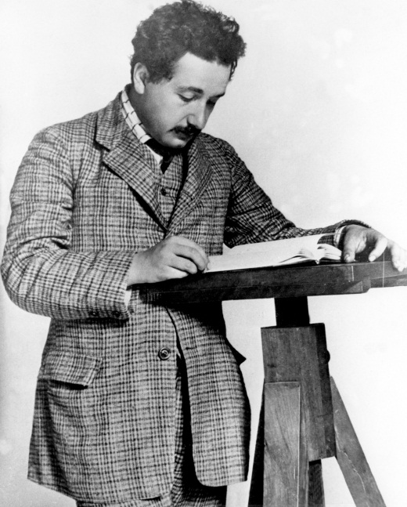
Greatness in the Kingdom
great
leader?
great
scientist?
great
footballer?
great
singer?
… teaching them to obey …
husband/wife
neighbour
employee
student
great
man/woman
father/mother
son/daughter
anyone who obeys and teaches God’s laws
(Matt. 5:19)

Slide 18
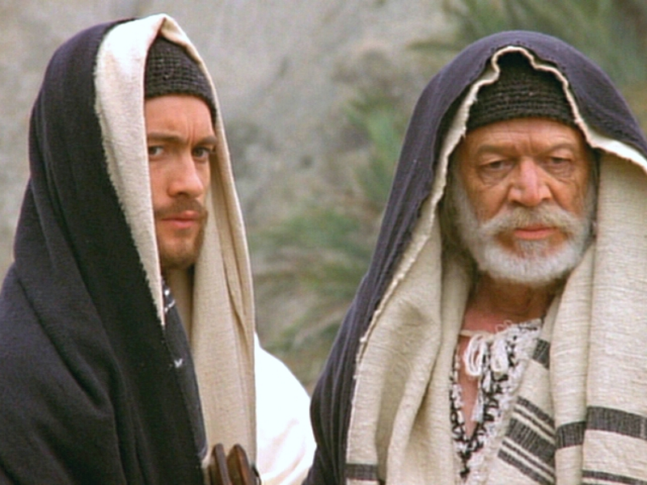
Greatness in the Kingdom
… better than the Scribes and Pharisees …
(Matt. 5:20)

Slide 19
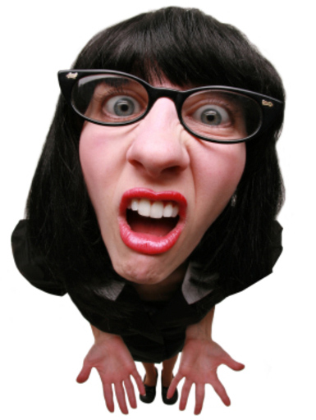
Greatness in the Kingdom
… better than the Scribes and Pharisees …
(Matt. 5:20)

Slide 20
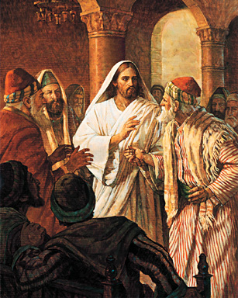
Greatness in the Kingdom
"For the Son of Man is Lord of the Sabbath." (Matthew 12:8)
"The Sabbath was made for man, and not man for the Sabbath.
(Mark 2:27)
“it is lawful to do good on the Sabbath”
(Matthew 12:12)
… better than the Scribes and Pharisees …
(Matt. 5:20)

Slide 21
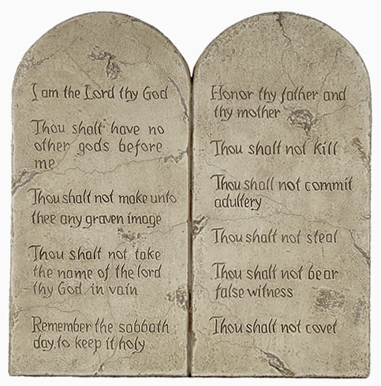
Greatness in the Kingdom
the Lord your God
love
neighbour
… old way …
… new way …
… better than the Scribes and Pharisees …
(Matt. 5:20)

Slide 22
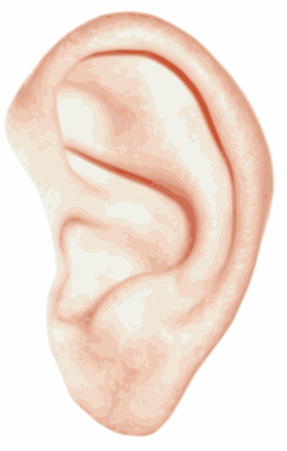
Greatness in the Kingdom
… murder …
… adultery …
… divorce …
… vows …
… revenge …
… enemies …
… you have heard …
… but I say to you …
… better than the Scribes and Pharisees …
(Matt. 5:20)

